Slide 1




Y Tywydd / The Weather

Slide 2
Amcanion / objectives
Nod: Trafod y tywydd / Discussing the weather
By the end of this gwers, you will be able to:
Comment on the tywydd,
Respond to comments made about y tywydd.
(And in a Welsh accent!)

Slide 3
Y cwestiwn:
Sut mae’r tywydd heddiw?
What’s the weather like today?

Slide 4

Y tywydd
‘It’ doesn’t exist yn Gymraeg, everything is either
‘he’ (‘fo’) or ‘she’ (‘hi’).
The weather (tywydd) is feminine.

Slide 5
Yr Ateb:
Mae hi’n ...... = It’s ......

Slide 6

Mae hi’n braf.
It’s fine/nice.

Slide 7

Mae hi’n sych.
It’s dry.

Slide 8

Mae hi’n boeth.
It’s hot.

Slide 9

Mae hi’n chwythu.
It’s windy.

Slide 10

Mae hi’n ddiflas.
It’s miserable.

Slide 11
Mae hi’n wlyb.
It’s wet

Slide 12
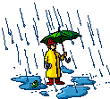
Mae hi’n bwrw glaw.
It’s raining.

Slide 13
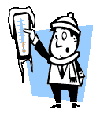
Mae hi’n oer.
It’s cold.

Slide 14
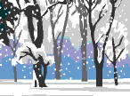

Mae hi’n bwrw eira.
It’s snowing!

Slide 15
Mae hi’n stormus.
It’s stormy.

Slide 16
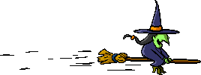
Y Treiglad Meddal!
Yn or ‘n trigger a Soft Mutation (Treiglad Meddal) in
adjectives (describing words) that start with the letter
P, T, C, B, D, G, Ll, M or Rh.

Slide 17
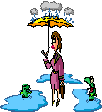
Mae hi’n ddiflas. Mae hi’n wlyb.
Mae hi’n boeth.
e.g.
Mae hi’n bwrw glaw!
Doing words (verbs) stay as they are after yn.

Slide 18
Tasg
Efo’ch partner, match the correct phrases with the pictures.

Slide 19

Mae’n oer!
You will often hear people say Mae’n instead of Mae hi’n, when conversing in Welsh.
Either is acceptable.

Slide 20
Cwestiwn
Weithiau (sometimes), you might hear this question asked aswell:
Mae hi’n braf, tydy?
Mae hi’n oer, tydy?
Mae hi’n ddiflas, tydy?
Mae hi’n wyntog, tydy?

Slide 21
Ateb:
Ydy, mae
hi’n …
Yes, it’s ...
Nac ydy, mae hi’n …
No, it’s ...

Slide 22
Tasg
Efo’ch partner, move around the track and say what the weather’s like.
Use the following question and answers:
Cwestiwn:
Mae hi’n ....., tydy?
Ateb:
Ydy / Nac ydy

Slide 23
Cwestiwn:
Hefyd, you might like to ask:
Ydy hi’n .....?
Is it ...?

Slide 24
Ateb:
Ydy, mae
hi’n …
Yes, it’s ...
Nac ydy, mae hi’n …
No, it’s ...

Slide 25
Ydy hi’n braf?
Ydy, mae hi’n braf!

Slide 26

Ydy hi’n braf?
Nac ydy, mae hi’n wlyb!

Slide 27
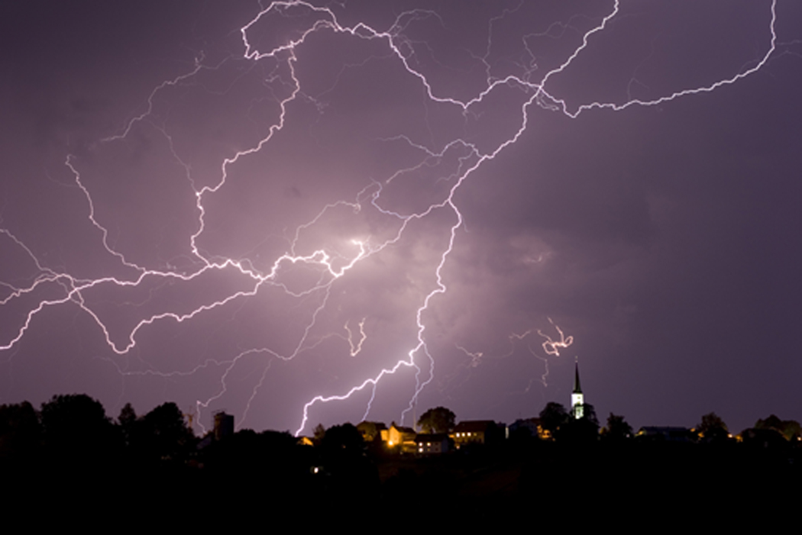
Deialog
Using the cards, go around the class to talk to your fellow dysgwyr yn Gymraeg!

Slide 28

Gwaith Cartref
Complete the diary by wythnos nesaf, os gwelwch yn dda.

Slide 29

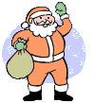
Wela i chi wythnos nesaf!
Nos da!

